Slide 1
CS 783
Assignment 4
Image Segmentation
Group No.
50
Somesh Kumar Jaishwal 18111071
Harshit Gupta 18111020

Slide 2
Problem Description
The task is to do semantic segmentation on IITK security surveillance dataset. Semantic segmentation is concerned with combining pixels sharing same characteristics.

Slide 3
Method Description
K-Means based semantic segmentation
Idea : Cluster pixels using K-Means on 5D feature representation of image pixels
Mean-Shift based semantic segmentation
Idea : Replace each image pixel by mean of its neighborhood pixels. (adv : Doesn’t need to specify number of cluster/segment type beforehand)
Nonparametric Bayesian Gaussian Mixture
Idea : Model/generate each image pixel by a set Gaussians. Fractional participation of each pixel in Gaussians. (adv of non param model: don’t need to mention the number of segment type/cluster beforehand, more generalizing power)

Slide 4
SLIC based Segmentation
Idea : Uses K-Means for the purpose. Generates superpixels based on local distribution of color similarity and proximity. Used CNN to augment the slic’d segments. (adv : compute efficient)
WNet based segmentation
Two tied FCNs, auto-encoder based. First half of encoder captures context, second half does localization. Uses soft normalized loss to penalize encoding and reconstruction loss to penalize reconstruction of original image (decoding).
WNet Naive : Trained WNet only by penalizing reconstruction loss.
WNet Soft-N-Cut : Trained WNet by penalizing both soft normalized cut loss and reconstruction loss.
Curated WNet : Our attempt to improve context capturing capability of network. Idea : Freeze second half of encoder (localization capability) of an already trained network. Train the model again. As the model now focuses on first half of encoder, it should improve its context capturing capability.

Slide 5
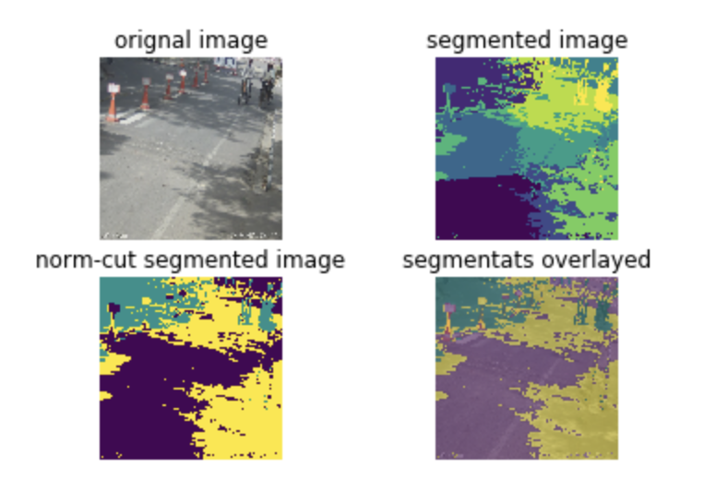
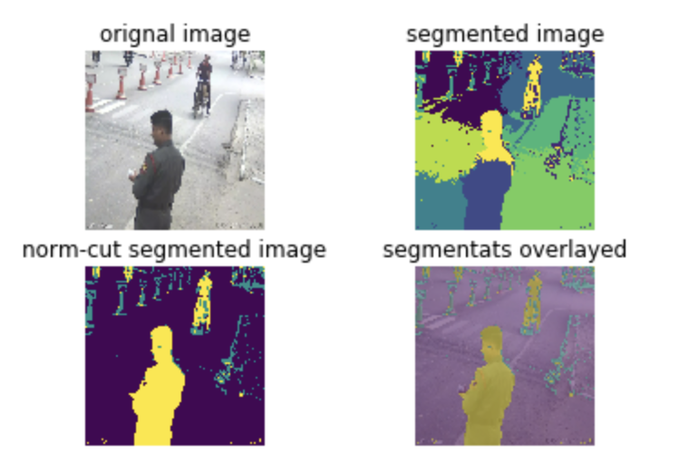
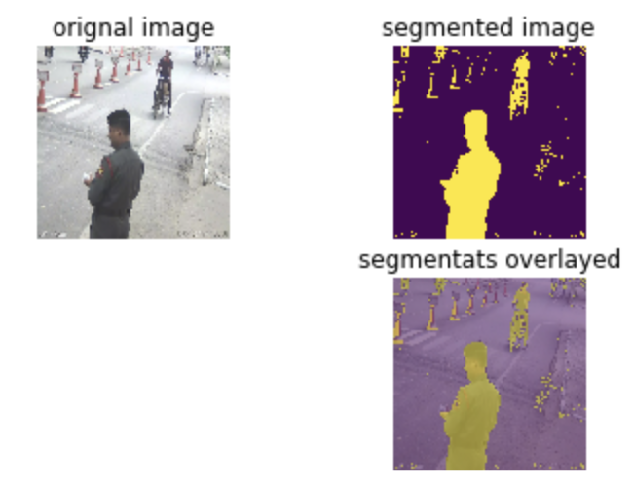
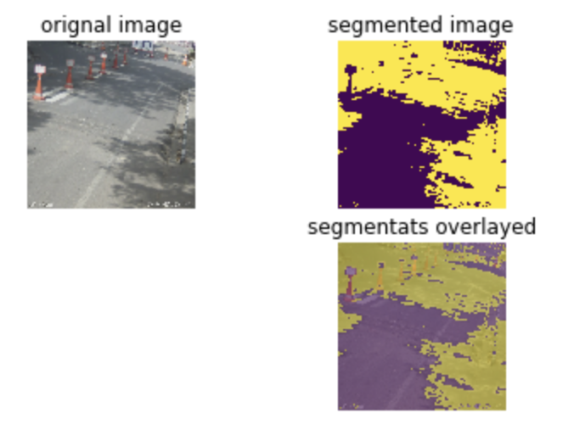
K-Means based :
Mean-Shift based:

Slide 6
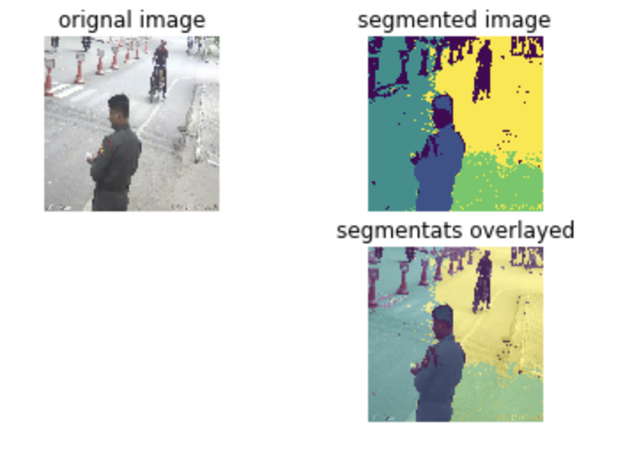
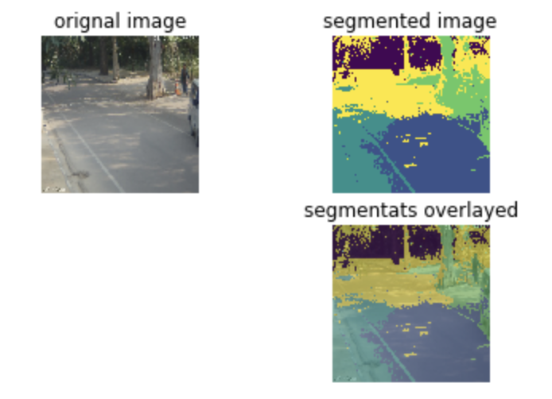
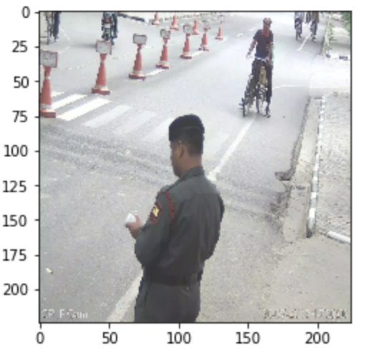
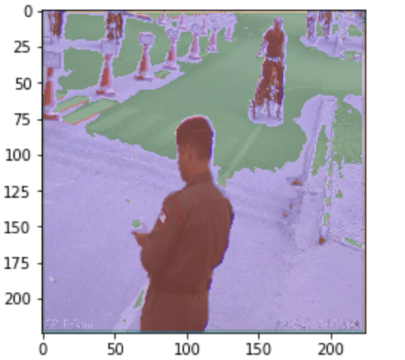
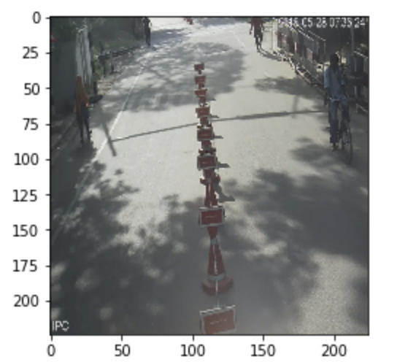
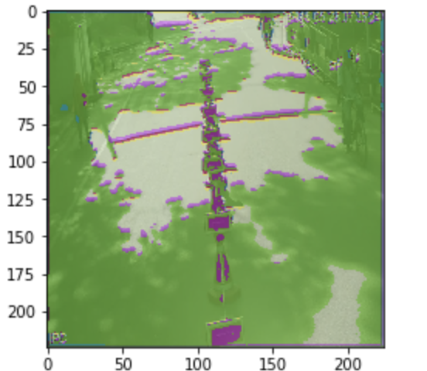
Nonparameteric Bayesian Gaussian Mixture based:
SLIC based :

Slide 7
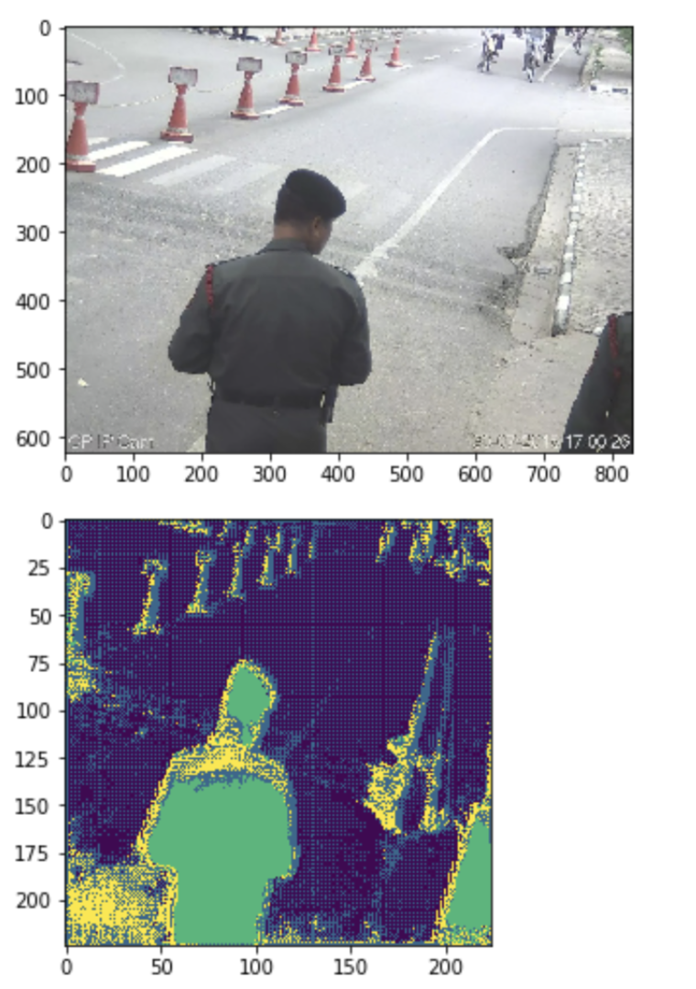
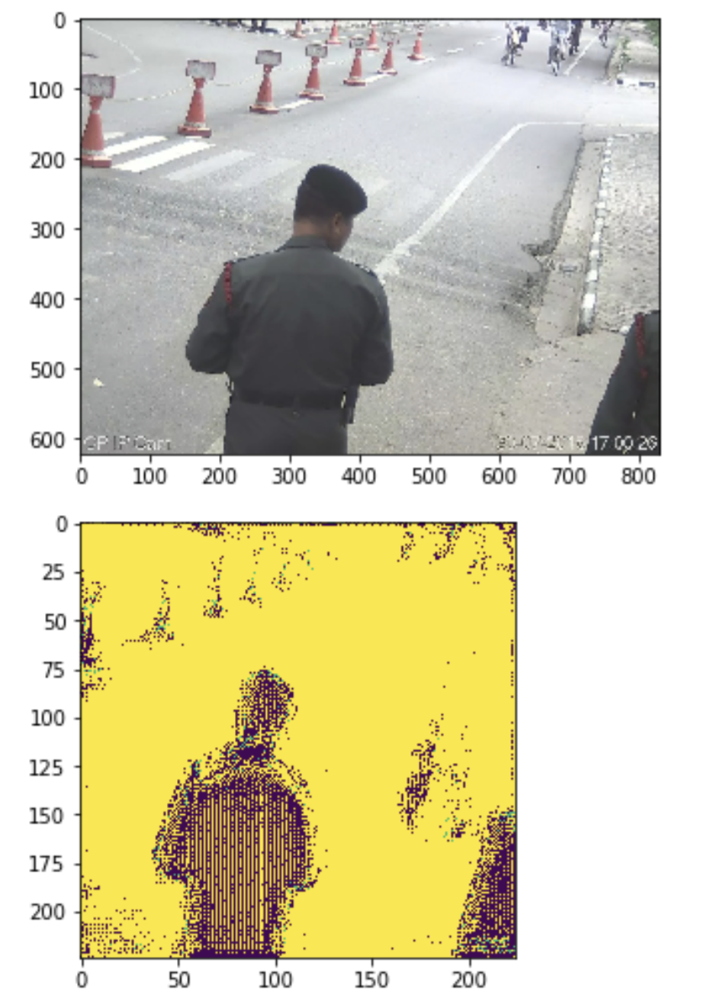
WNet Naive based
WNet SoftNCut based

Slide 8
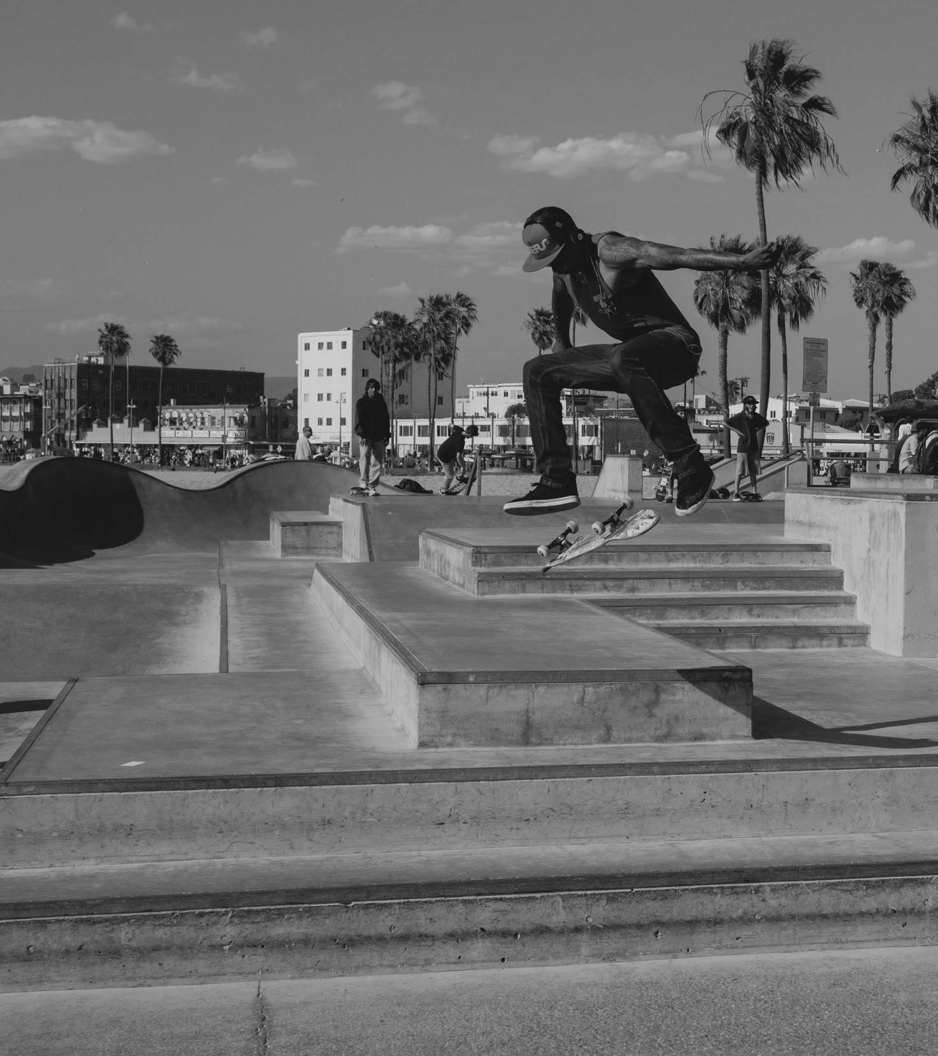
Thank You !!

